Slide 1

Exchange Summary
Antonija Cunningham, Regina Catholic School Division
November 18, 2021
What is the CSCC doing well to support the school goals, and where is there opportunity for improvement?

Slide 2

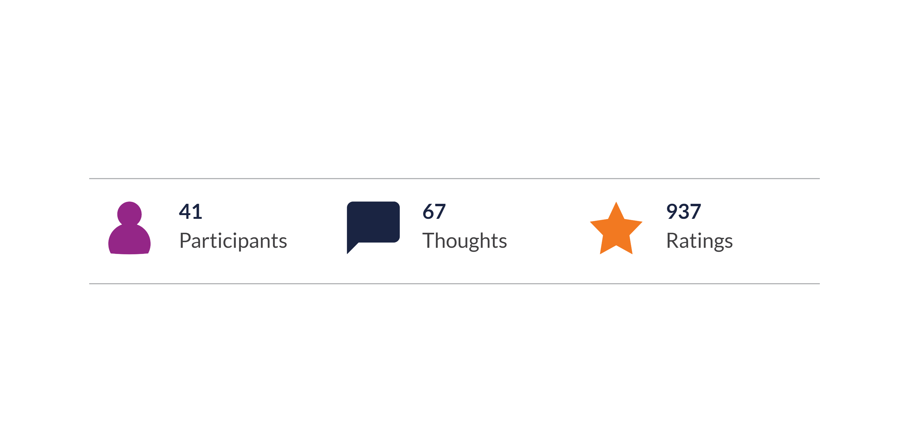
PARTICIPATION
Breakdown of Participation

Slide 3

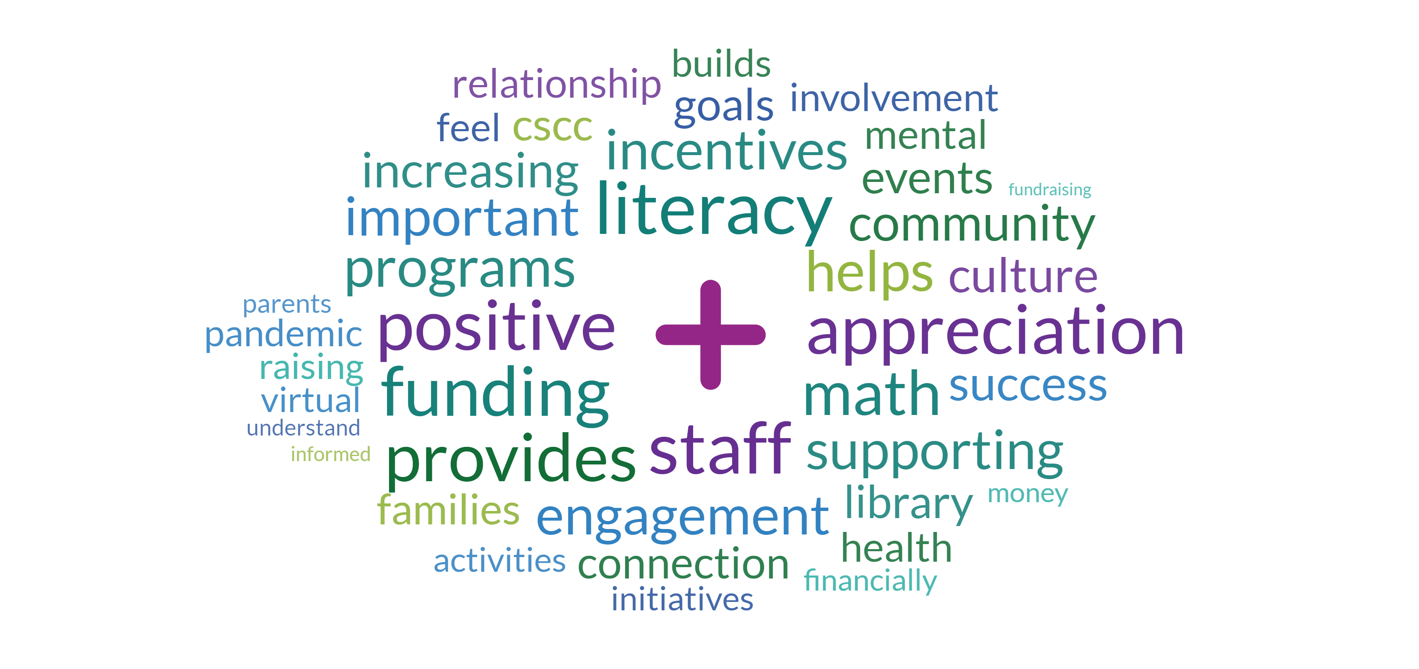
WORDCLOUD
Top Rated

Slide 4

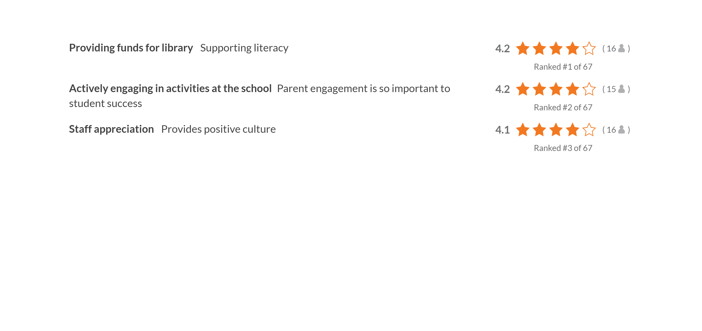
THOUGHTS
Key Thoughts

Slide 5

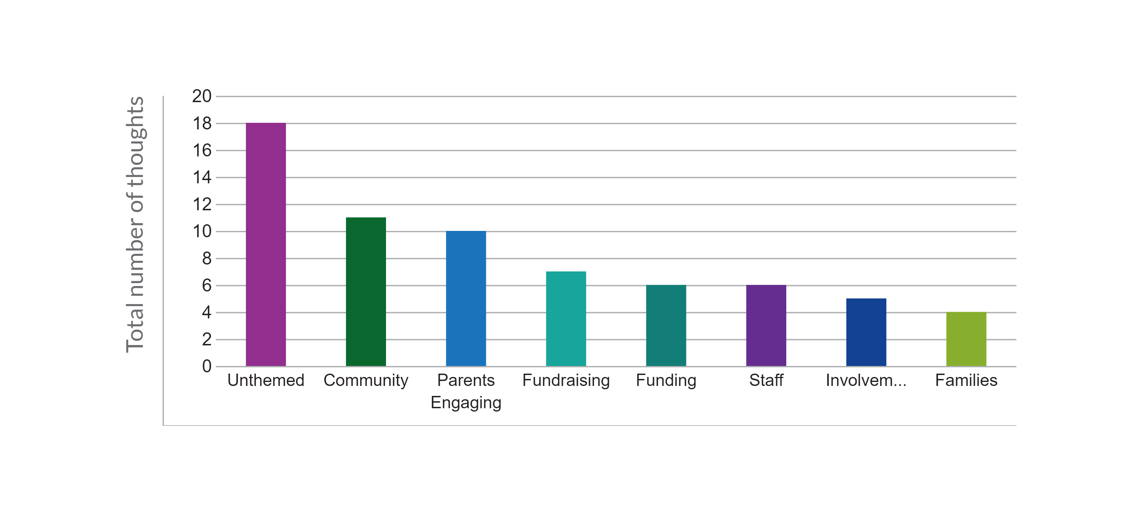
AI GENERATED THEMES
Top Themes by total thoughts

Slide 6
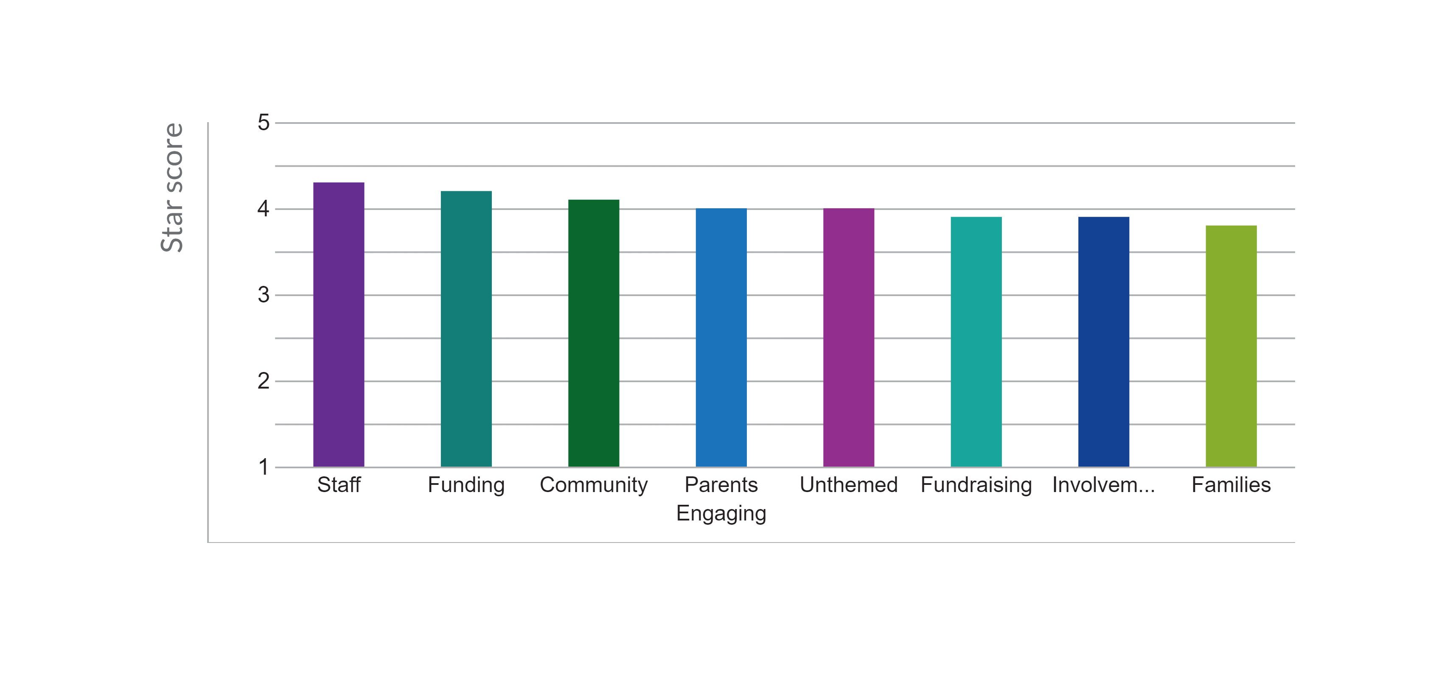
AI GENERATED THEMES
Top Themes by star score

Slide 7
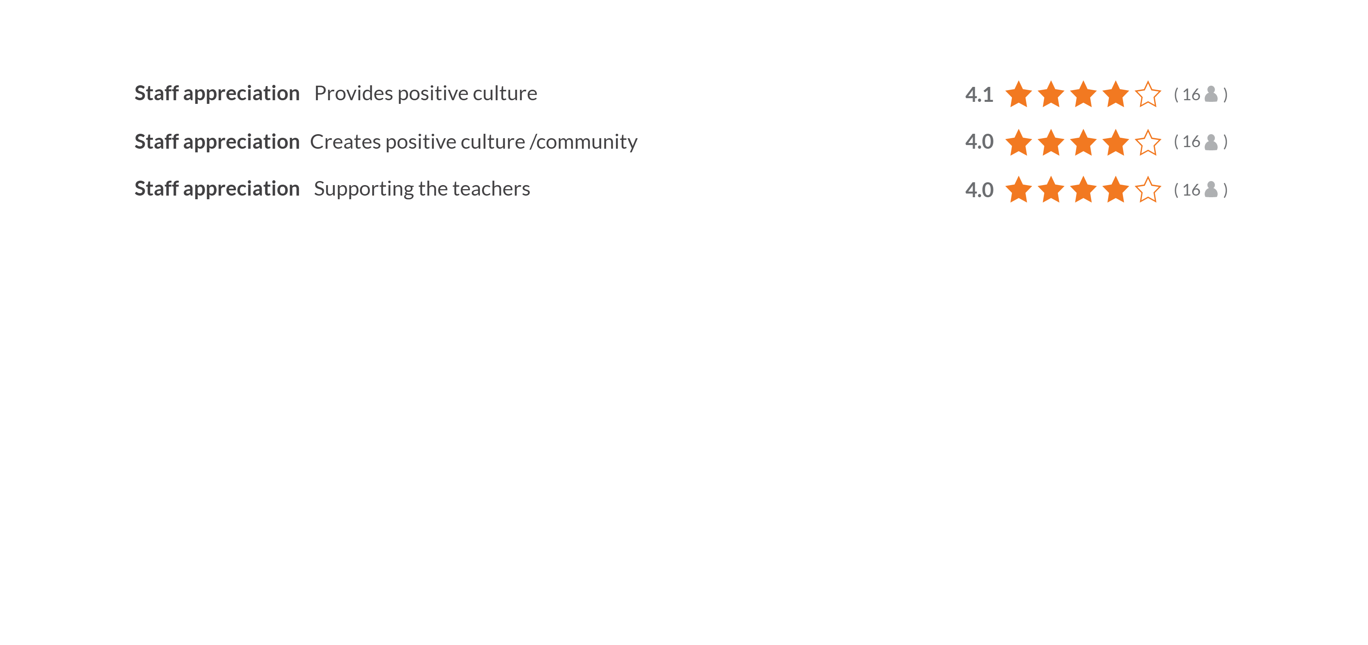
THOUGHTS
Staff

Slide 8
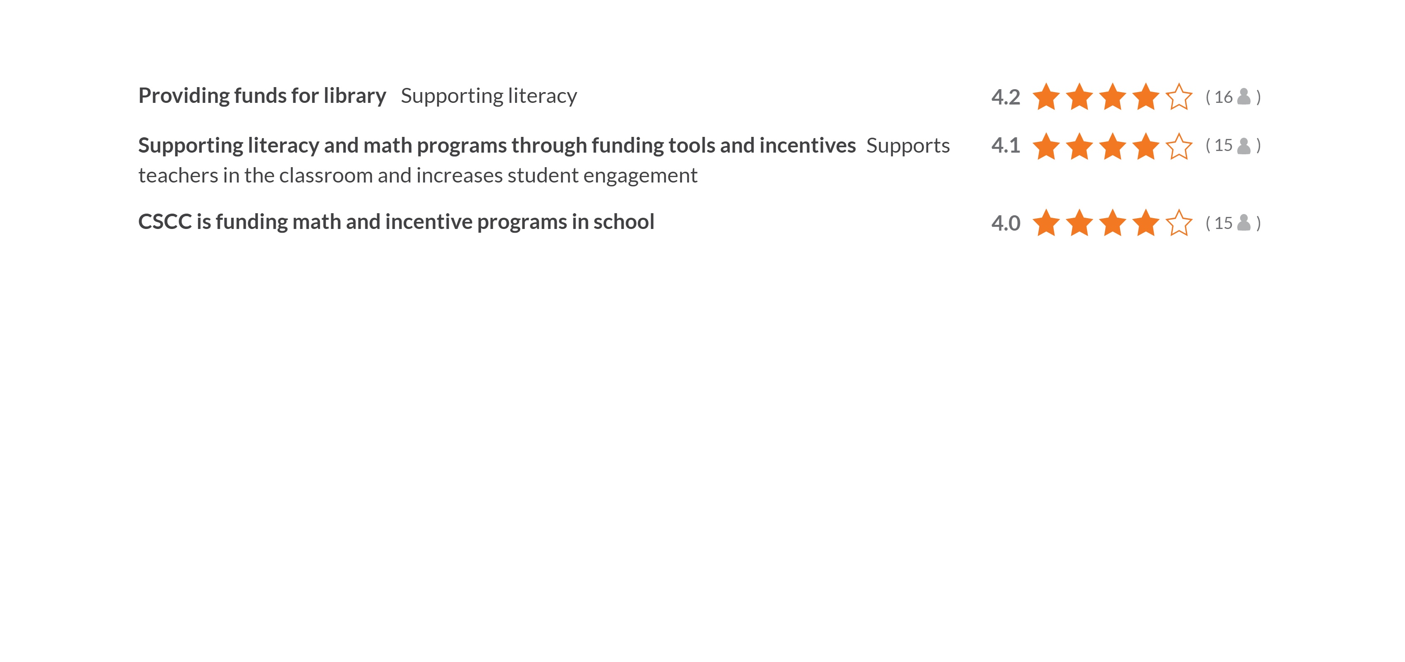
THOUGHTS
Funding

Slide 9
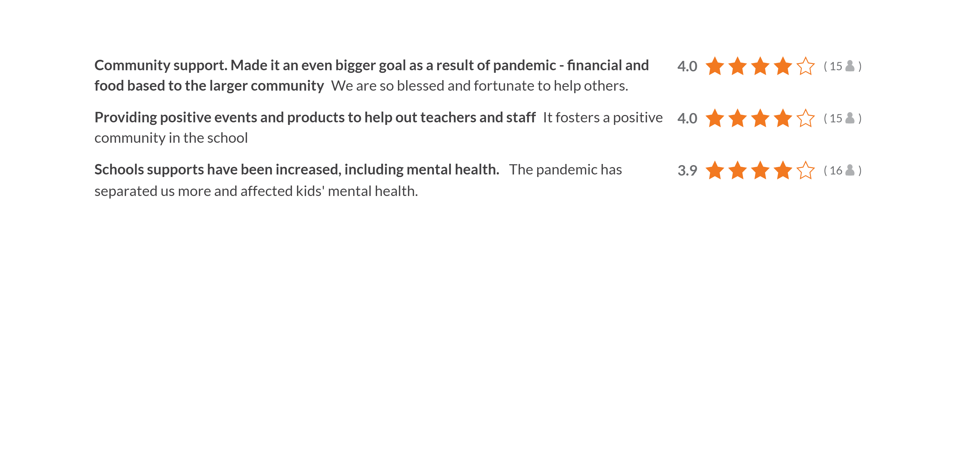
THOUGHTS
Community

Slide 10
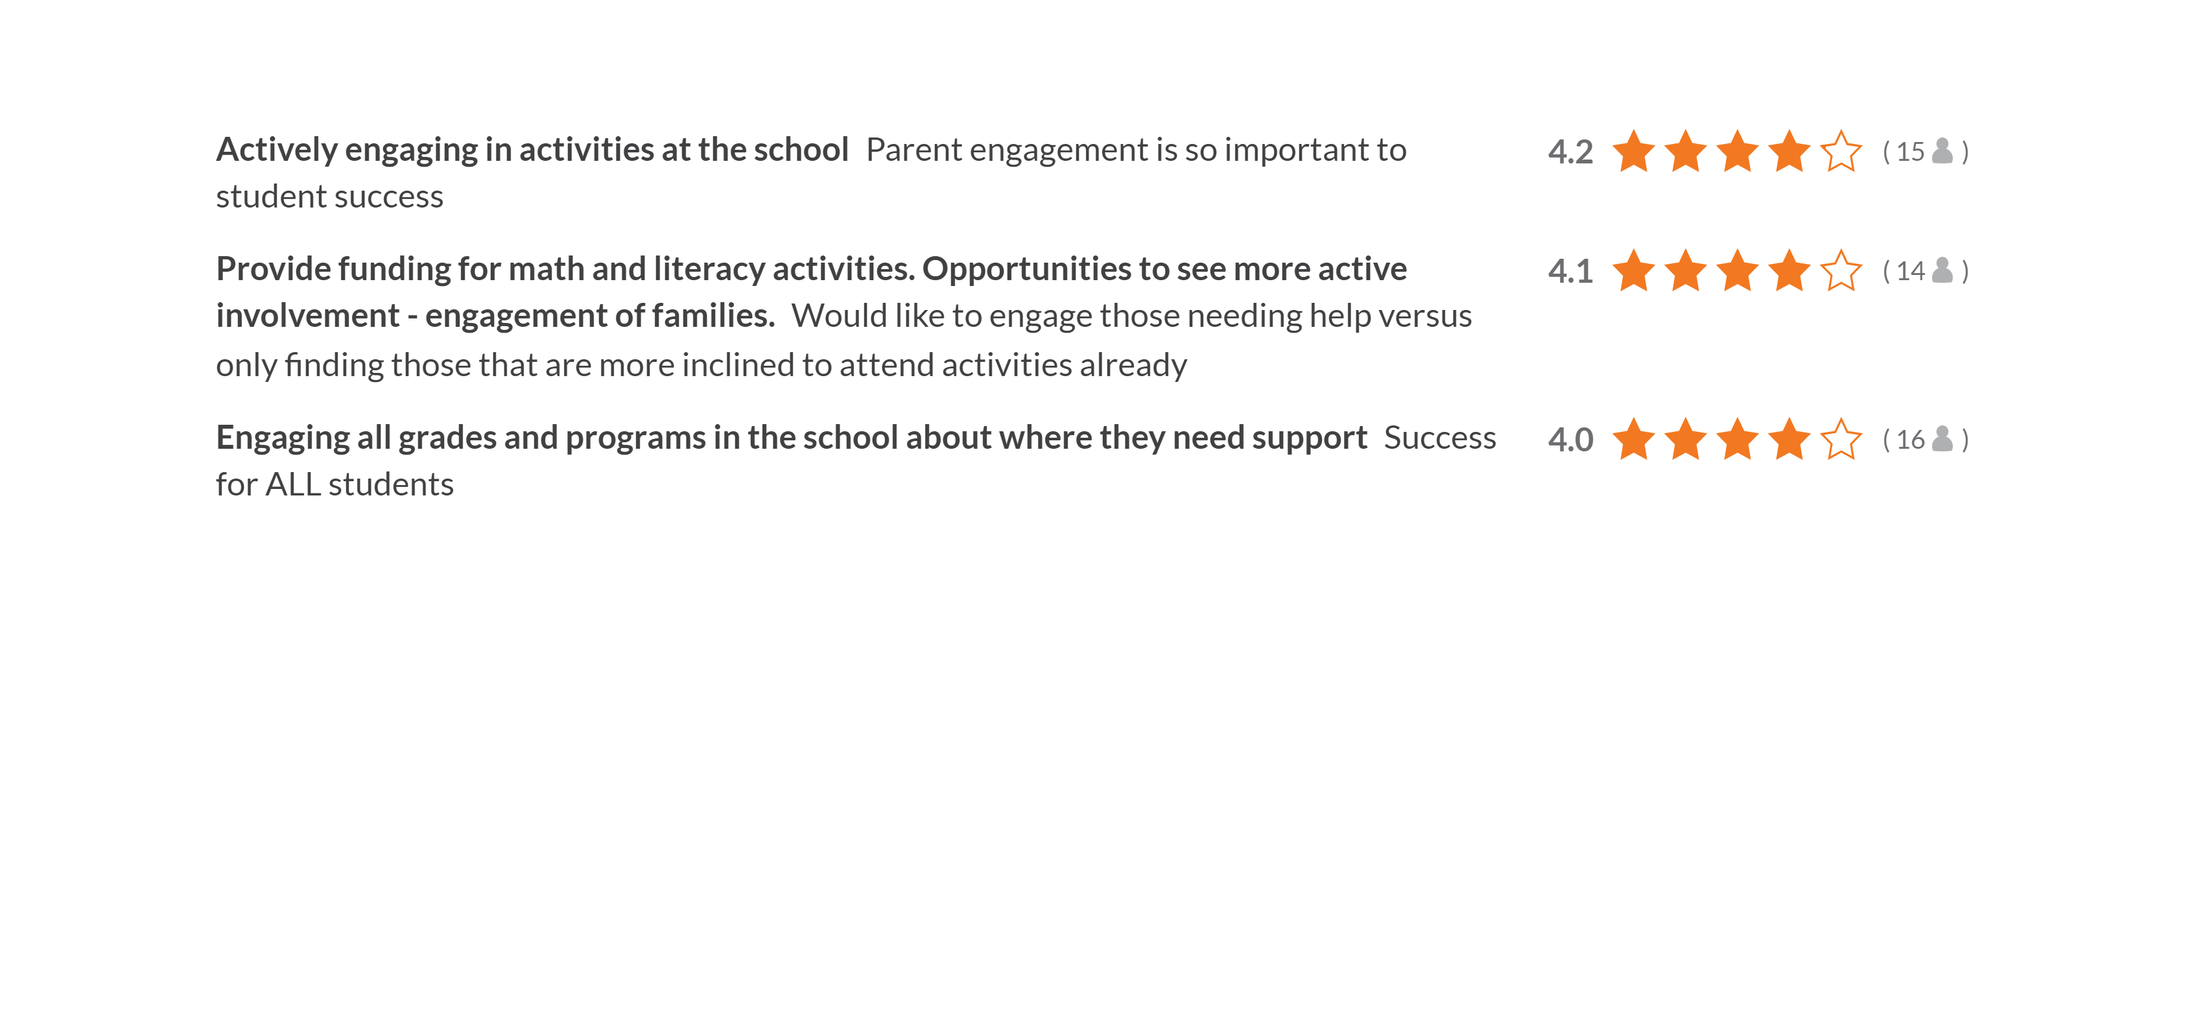
THOUGHTS
Parents Engaging

Slide 11
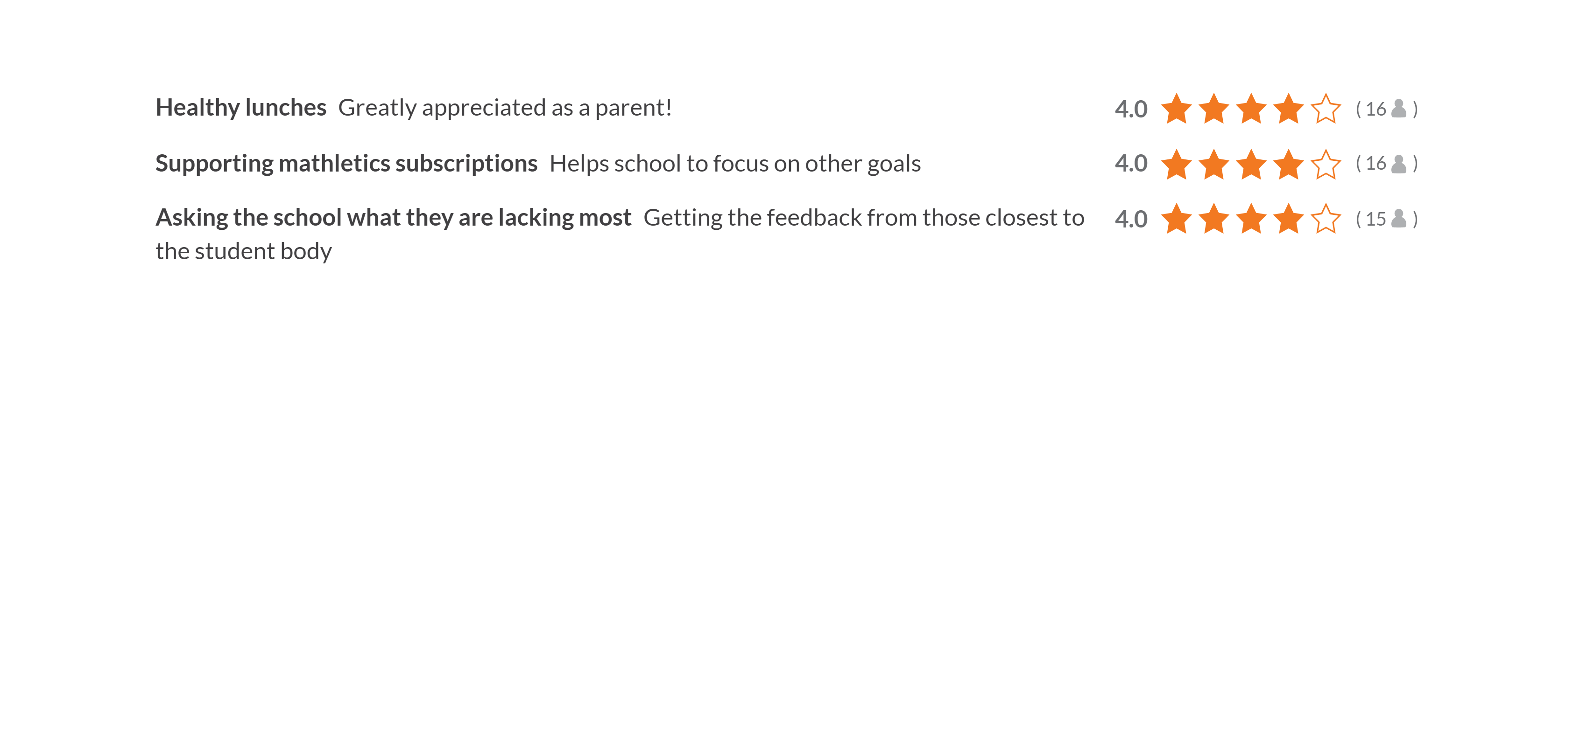
THOUGHTS
Unthemed

Slide 12
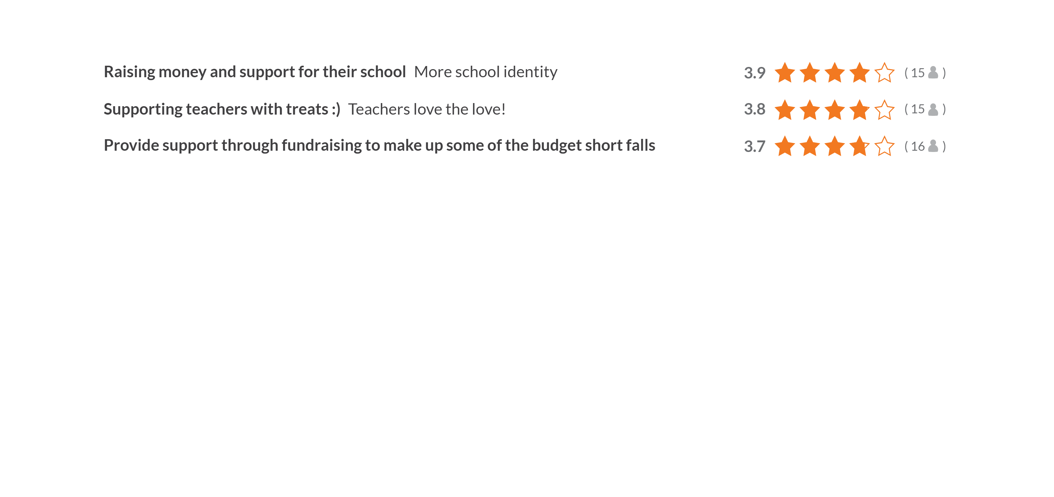
THOUGHTS
Fundraising

Slide 13
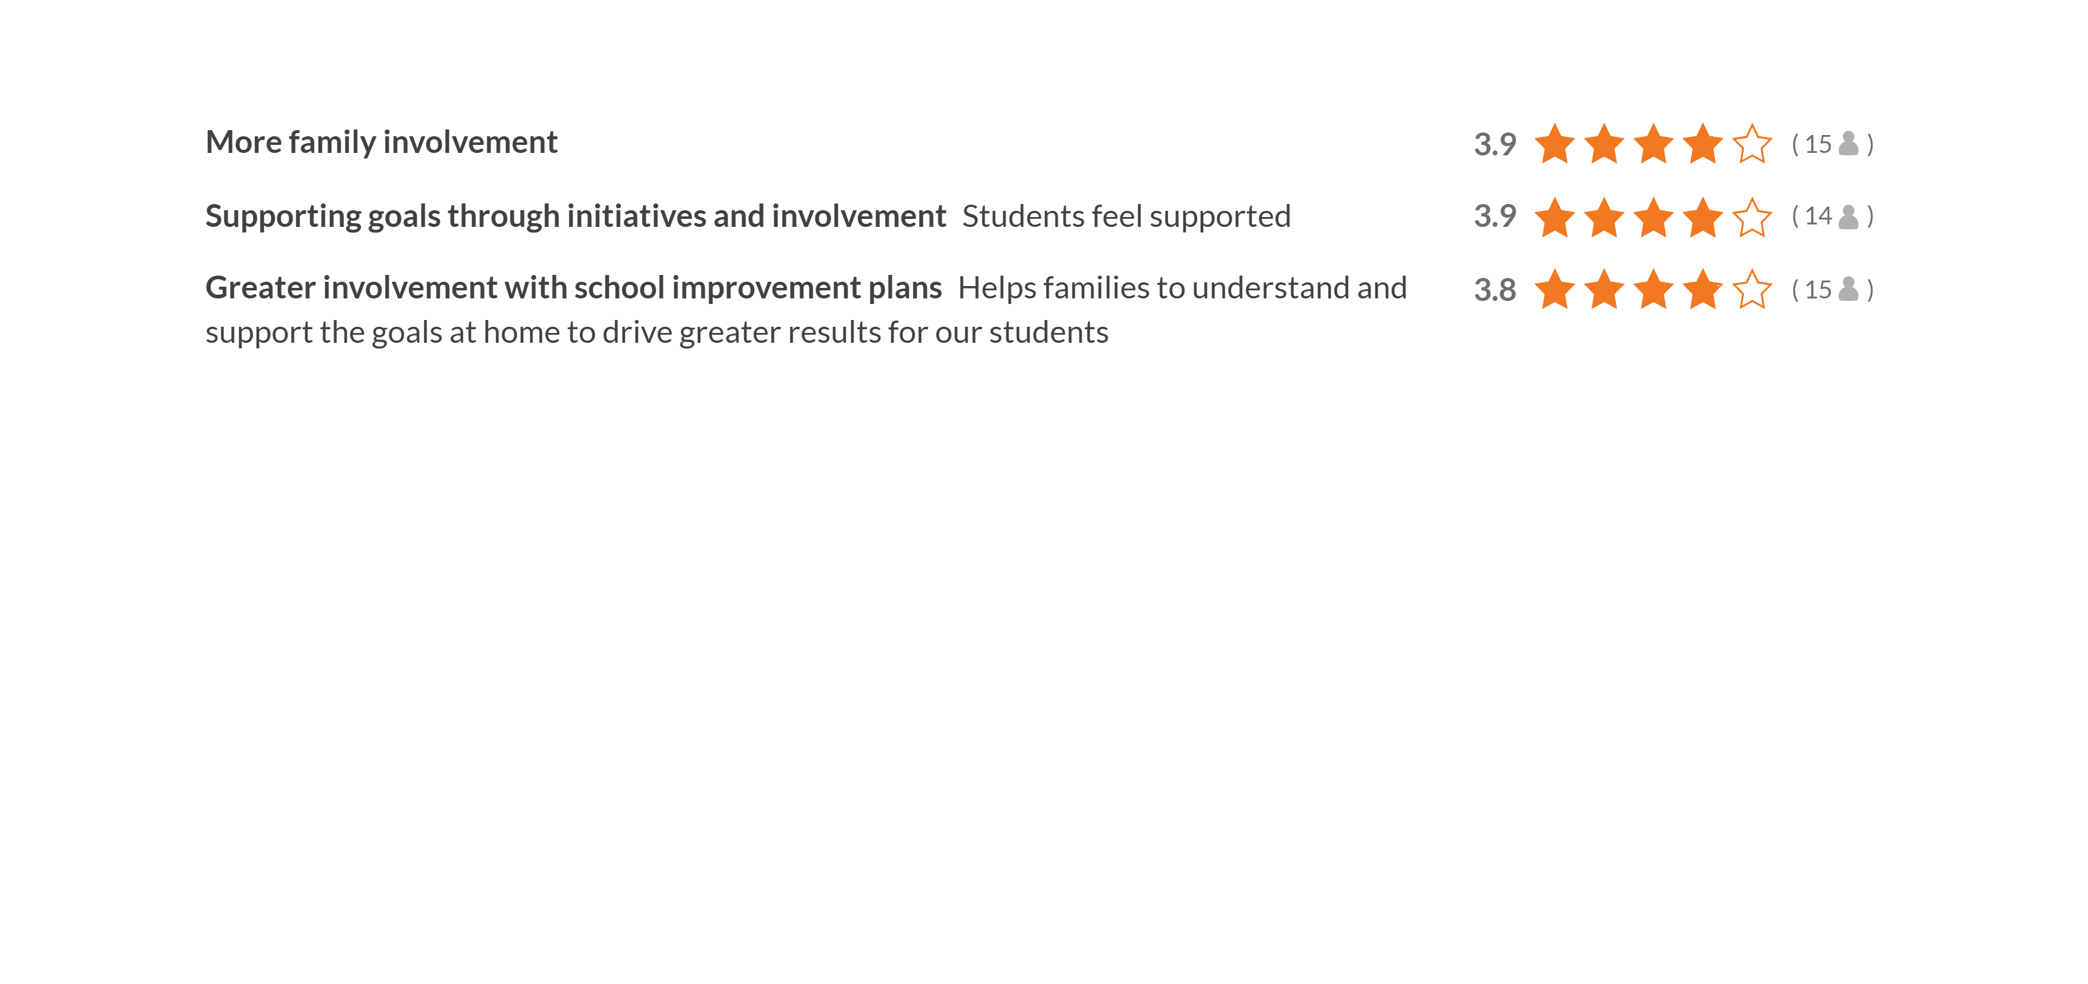
THOUGHTS
Involvement

Slide 14
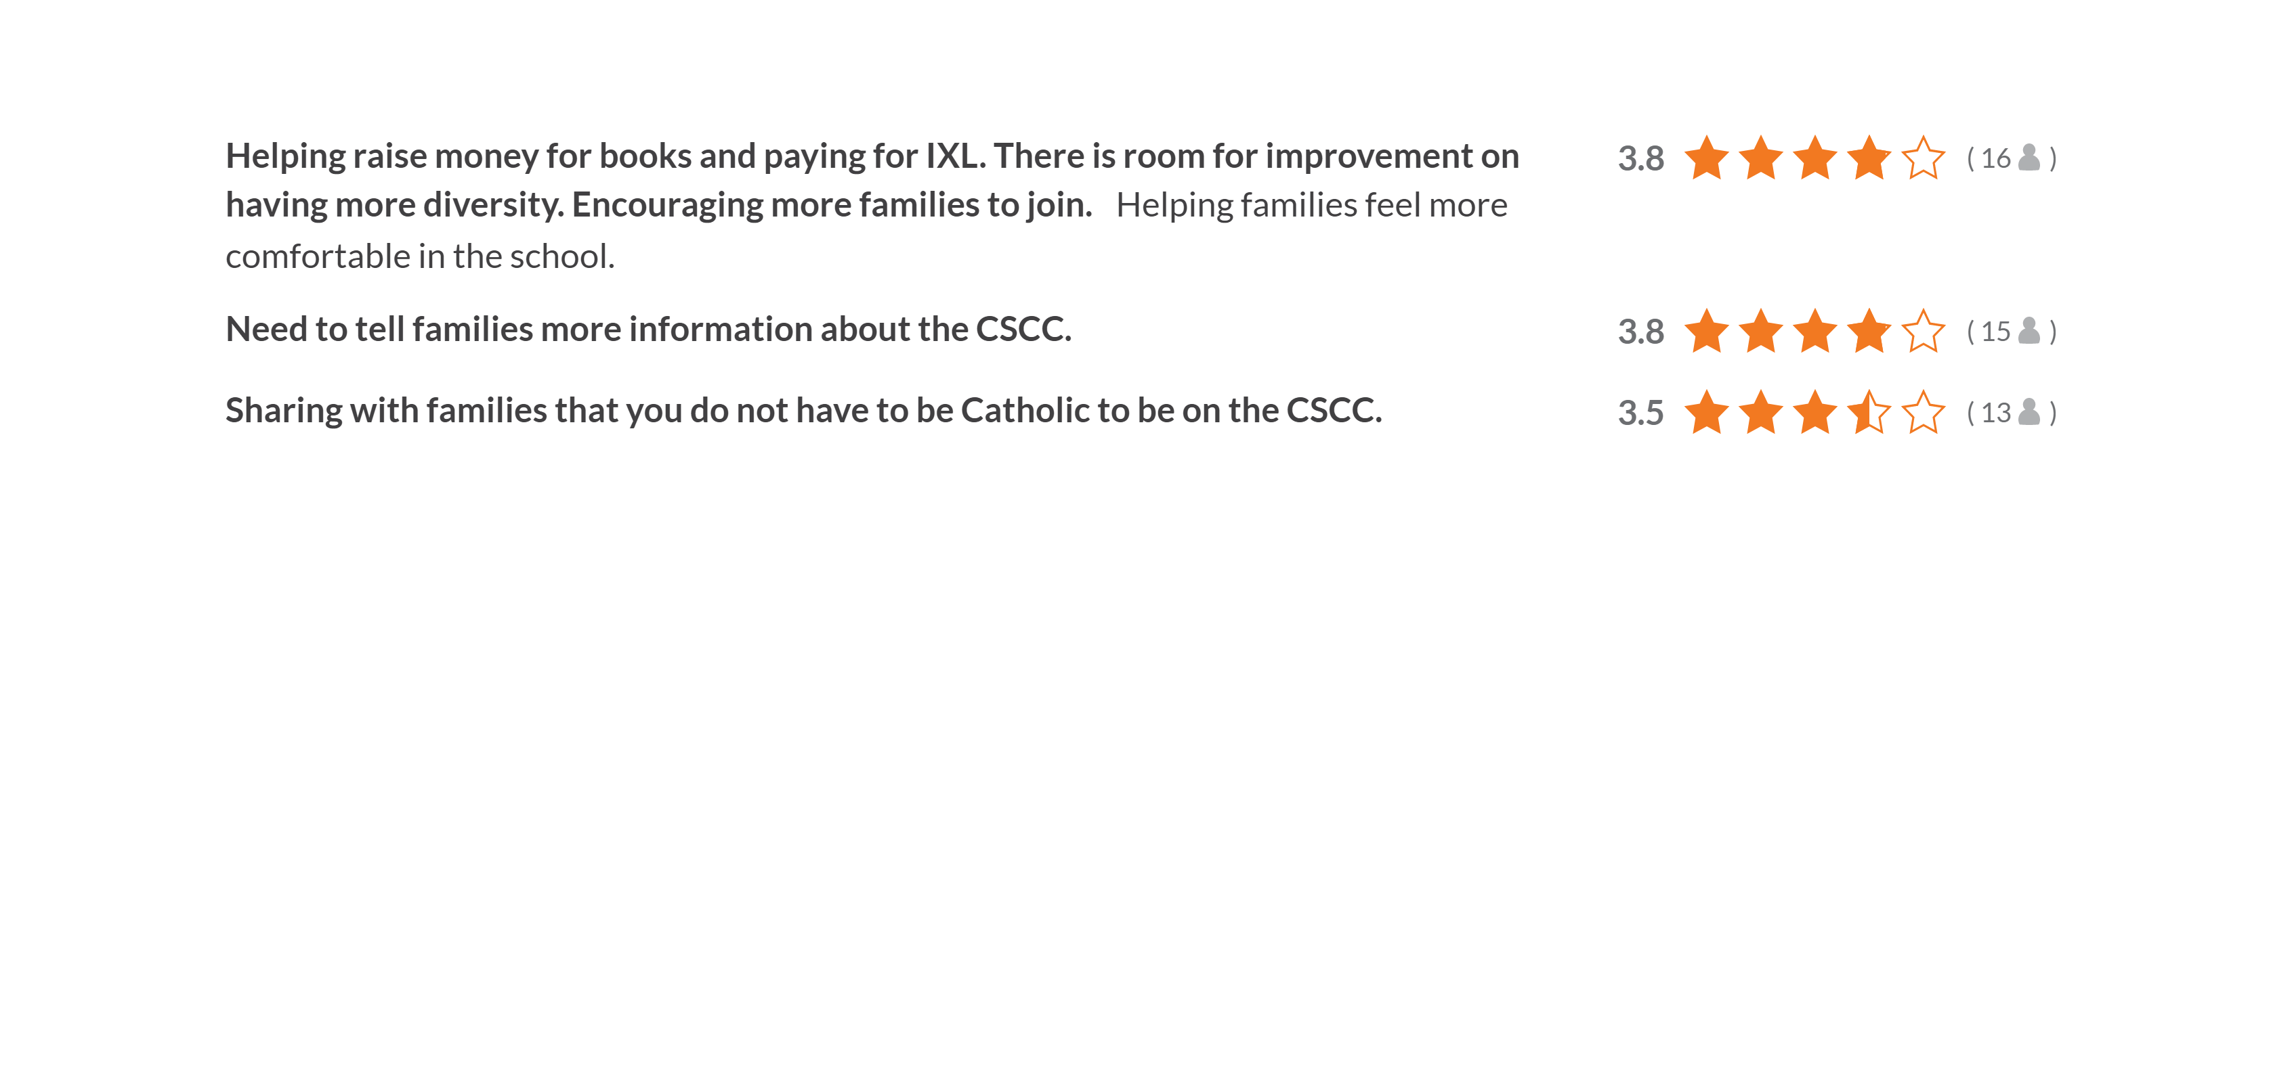
THOUGHTS
Families

Slide 15

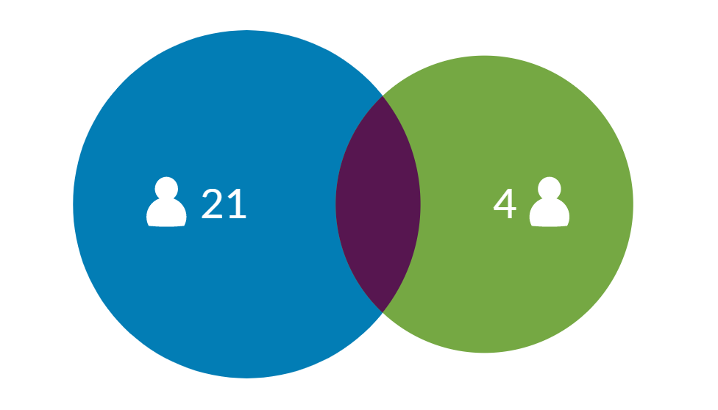
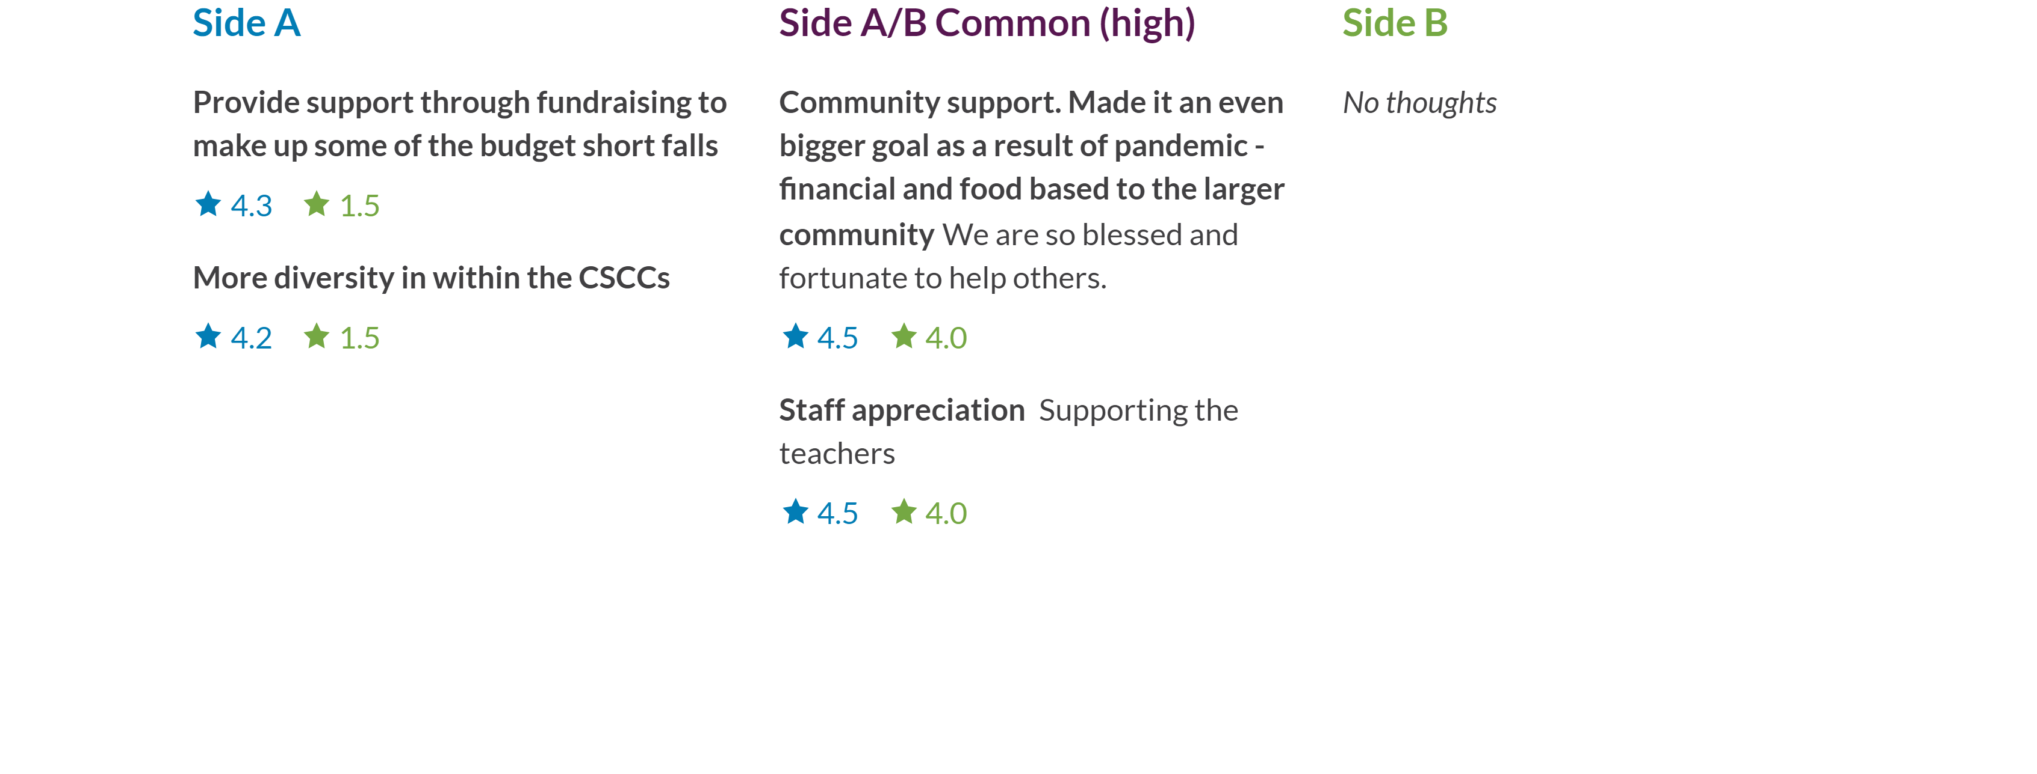
DIFFERENCES
Involvement [21 | 4]

Slide 16
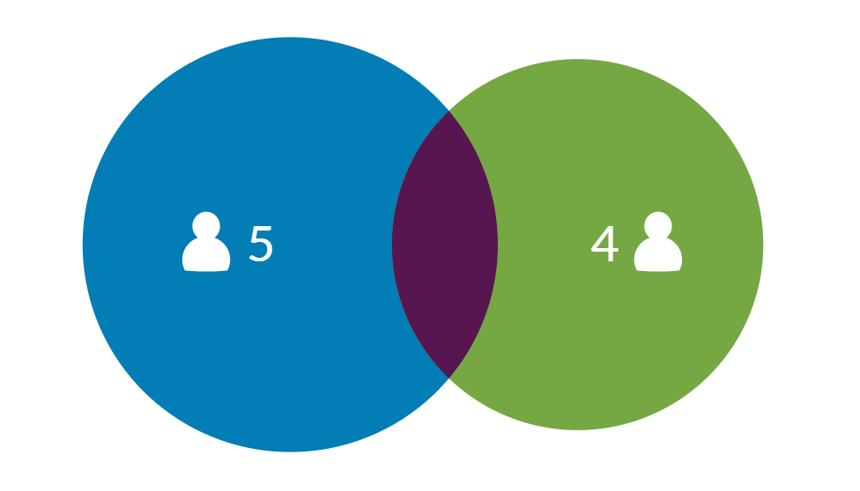

DIFFERENCES
Parents [5 | 4]

Slide 17

WRAP UP
Next Steps
Thanks for participating
‌
We'll be carefully considering what we learned and sharing our actions back with you.

