Slide 1
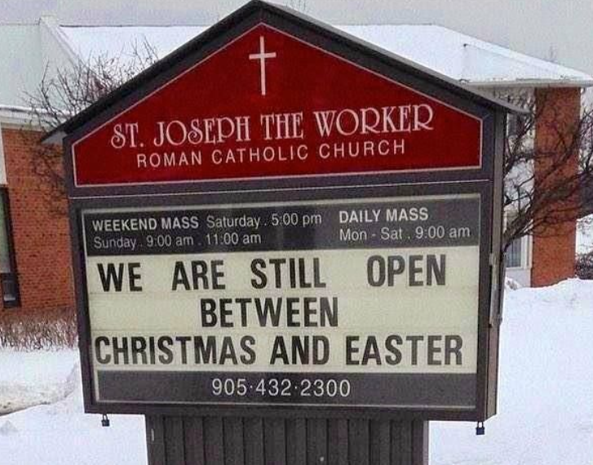
Website Wednesdays The best day of the week! January 10 & 17
Menu Maintenance
Registration Forms Ready

Slide 2
Menus
Your website menu shouldn’t need frequent editing, but it shouldn’t be ignored, either. Let’s talk about when and why you might need to make a change, and go over how to do it.
Hint: this one is very simple!

Slide 3

Website Wednesday Tasks
Please check that your registration forms are working and let me know if there are any issues. Then you’ll be entered to win… and I’ll come around with prizes before the February break!

Slide 4

Questions? Send them my way now or wait until next session.

Slide 5
2023-2024 Website Wednesdays 3:45 – 4:30 on Teams
Upcoming WWs
February 7, 14
March 6, 13
April 3, 10
May 1, 8
June 5, 12

Slide 6
Links
Create Events
Umbrella Video
Imagine Everything: The Basics

Slide 7
September
Calendar Updating
October
Adding news
November
Alerts
December
Dead link December
January
Menu maintenance
Hero banner
Posting article
Updating contacts and quick links
Registration forms
February
Pulling from Edsby
Post on Edsby and pull to web
March
Waffle talk
April
Image gallery management
May
Document management
June
Prep for summer
Keeping content fresh
Adding student smiles
Out of date document check
School supply lists
Topics may change throughout the year
Off-topic questions are always welcome

Slide 8
Registration Forms
Task #5 – post your registration forms
Make sure you have the correct links and that they are very easy to find. Registration should be so obvious that a potential student’s parent can’t help but register with you!
Send me a screen shot to win!

